Slide 1
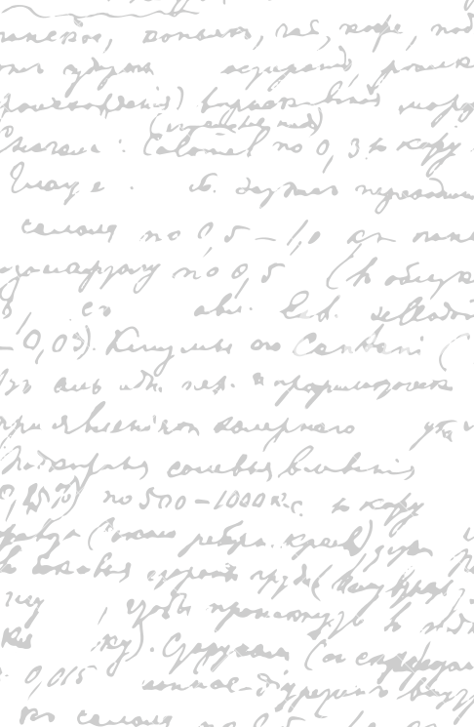



Ming Wu (Andrew) 2133861w
Laser Mate!
Project Supervisor Meeting 13
12 February 2021

Slide 2
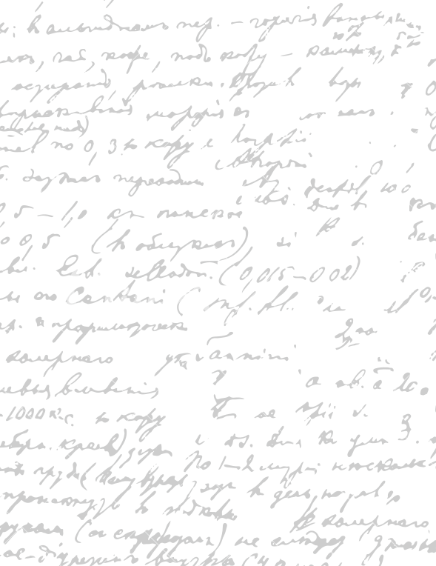



Start Recording

Slide 3
Main Topics
Evaluate dissertation
Rank what to do first

Slide 4

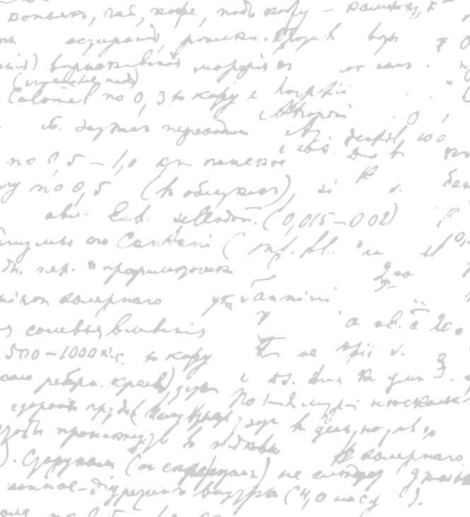

Evaluate Dissertation
Parts
Ask Stephen to read the whole dissertation in the order he wants for refinement and evaluation

Slide 5
2. Rank Project Parts
Writing Dissertation - xx
Software Coding -xx
Evaluation -xx

Slide 6
End

